Slide 1
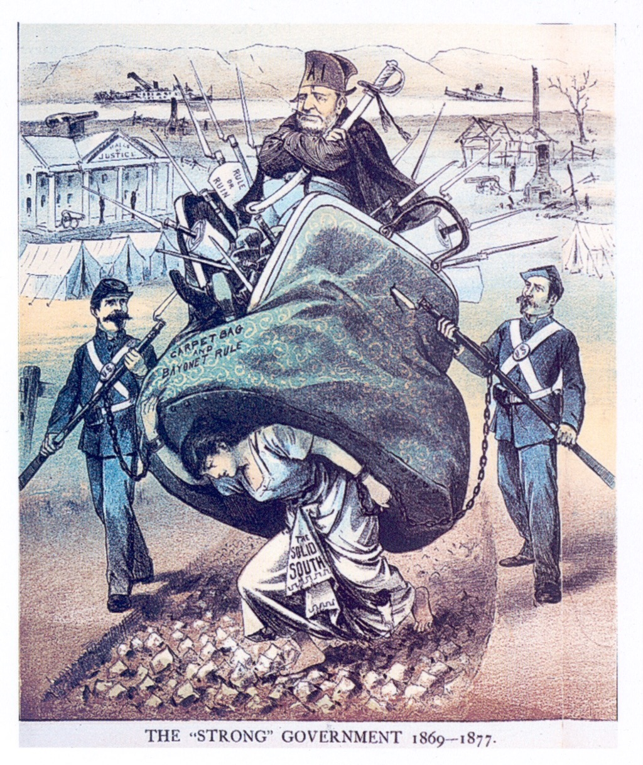
1. What is President Grant standing in? What does it symbolize?
2. What does the cartoonist mean by showing the woman carrying Grant on her back.
3. Why is the woman shown chained to the soldiers?
4. How did Grant deal with the South during his administration?
5. Do you think that this cartoon is set in the South or in the North? Explain.
DAY 4
Place Date Here
Notes:
Reconstruction
This Cartoon shows President Grant riding in a carpetbag that is bristling with bayonets.
1. The carpetbag symbolizes Northern Republicans whom Southerners accused of hastily moving to the South (carrying cheap bags) to grab power and seek wealth after the civil war.
2. The South bore the burden of Grants policies.
3. It reflects the status of the South during Reconstruction as prisoners of the federal government under military rule.
4. Grant willing sent federal soldiers to the South to keep order and enforce the law - some called this “bayonet rule” - during Reconstruction. He oversaw the implementation, in 1870, of the Fifteenth Amendment, under which African Americans in the South helped vote many Republican reformers-freedmen, carpet baggers, and scalawags-into public office. By 1872, however, as corruption plagued the administration and voters lost interest in Reconstruction, the solid South had begun to reverse many Republican reforms.
5. Probably the South- soldiers, a tent camp, and cannons represent the presence of the Northern army in the South; some ruined homes appear in the background; also in the background a ship appears to be sinking, which might symbolize the South’s sinking economy.

Slide 2
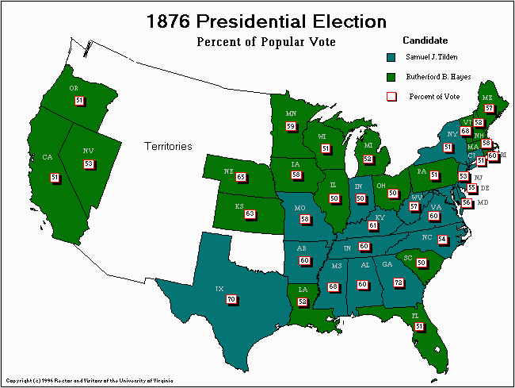
• White Southerners, formed a bloc of Democratic voters called solid South
A. A Dying Issue
1. Heavy spending put
S. states in debt
2. Symbolized corruption
3. S. states blocked Reconstruction
4. 1873 - economy fell
Notes:
= 1. Reconstruction legislatures taxed and spent heavily, putting southern states into deeper debt., as well as heavy spending by the Federal Government.
2. Reconstruction came to symbolize corruption, greed, and poor government.
3. White dominated southern states blocked many federal Reconstruction policies.
- In additon the Supreme Court, in a series of cases, narrowly interpreted
4. A nationwide economic downturn in 1873 diverted public attention from the movement for equal rights. And really, many white northern voters had never fully supported the Radical Republican’s goal of racial equality

Slide 3
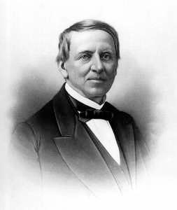
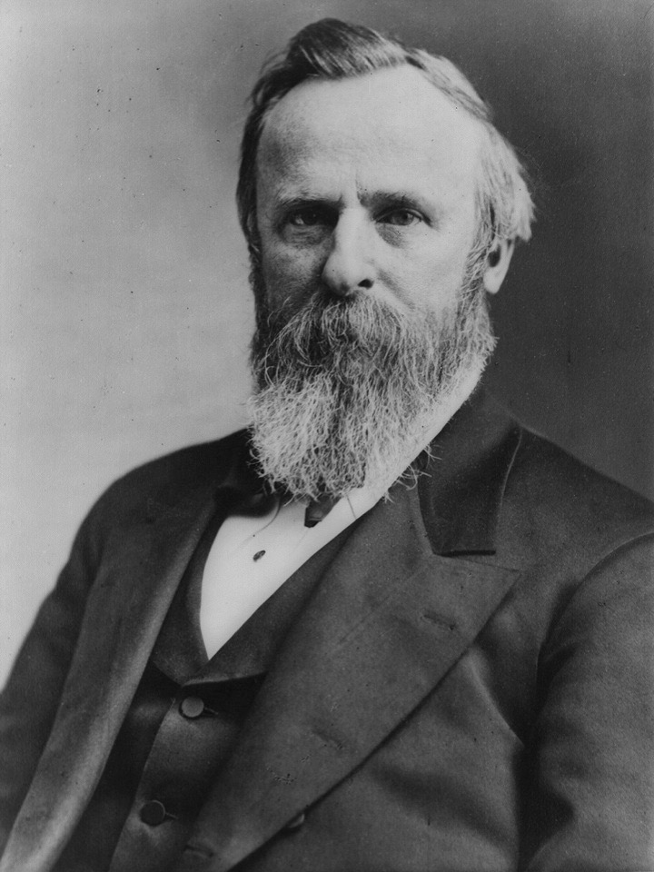
B. Election of 1876
Election of 1876
Compromise of 1877 -
- Hays(R) becomes Pres.
- Troops leave the S..
- more money for S. industrialization
- appoint Dems to positions
Vs.
Samuel J. Tilden
Democrat
Rutherford B. Hays
Republican
Notes:
The election of 1876 marks the end of Reconstruction.
In the election, Republican Rutherford B. Hays lost the popular vote to Democrat Samuel Tilden, who had the support of the Solid South. The electoral vote, however was disputed.
Hayes claimed victory based partly on wins in Florida, Louisiana, and South Carolina. Those states were still under Republican and federal control. Democrats submitted another set of tallies showing Tilden as the winner in those states, and thus the presidential race. No one even today, really knows who won those states. Congress set up a special commission to resolve the election crisis. The commission included more Republicans than democrats named Hays the winner. BUT Democrats had enough strength in Congress to reject the commission’s decision.
Finally the two parties made a deal.

Slide 4
B. Election of 1876
Election of 1876
Compromise of 1877 -
- Hays(R) becomes Pres.
- Troops leave the S..
- more money for S. industrialization
- appoint Dems to positions
Vs.
Samuel J. Tilden
Democrat
Rutherford B. Hays
Republican
Notes:
An embedded link to a 2:14 minute Election of 1876 YouTube video begins here.
Mac users, click on black circle to open browser and view a 2:14 minute Election of 1876 YouTube video.
Original Link: https://www.youtube.com/watch?v=2H0_7xeF868&list=UUah6AOt0N8Az0V9URLUQPWA
The election of 1876 marks the end of Reconstruction.
In the election, Republican Rutherford B. Hays lost the popular vote to Democrat Samuel Tilden, who had the support of the Solid South. The electoral vote, however was disputed.
Hayes claimed victory based partly on wins in Florida, Louisiana, and South Carolina. Those states were still under Republican and federal control. Democrats submitted another set of tallies showing Tilden as the winner in those states, and thus the presidential race. No one even today, really knows who won those states. Congress set up a special commission to resolve the election crisis. The commission included more Republicans than democrats named Hays the winner. BUT Democrats had enough strength in Congress to reject the commission’s decision.
Finally the two parties made a deal.

Slide 5
SUCCESSES
• Rebuilt Union & repaired the S.
• Freedmen’s Bureau helped some blacks gain housing, jobs & education.
• S. gets public school system
FAILURES
• Most Blacks stayed poor, no property, opportunity, & political power
• Blacks lost the vote
• Racism didn’t stop
• Southerners hated Fed Gov. & Republicans

Slide 6
Describe one important thing you learned in class today.

