Slide 1
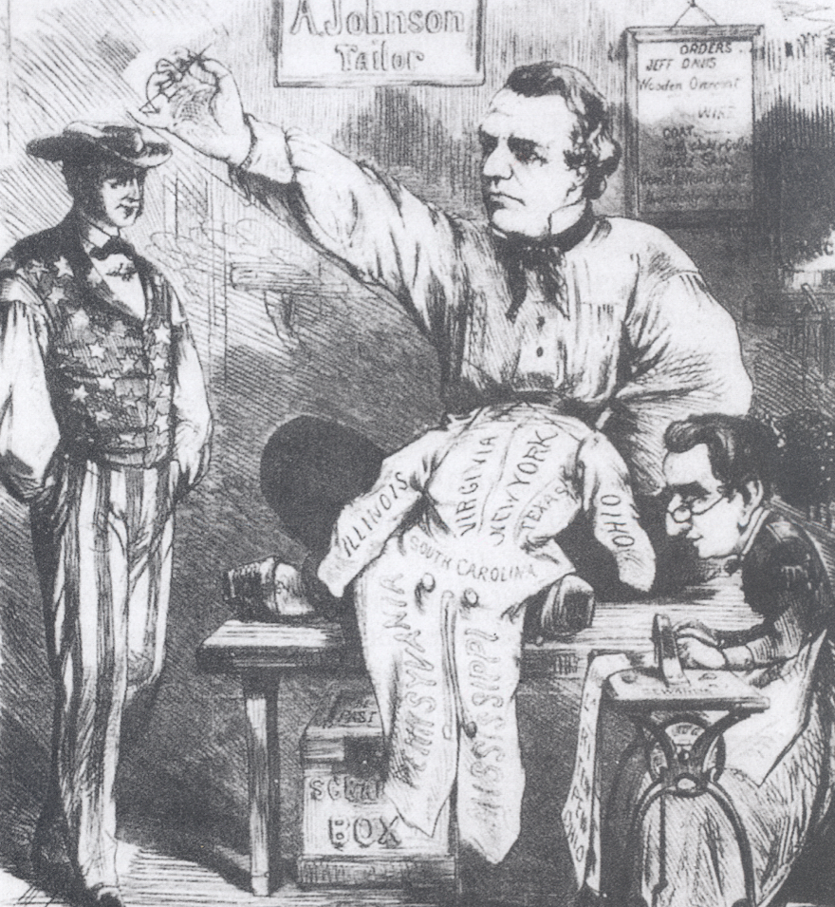
1. How do we know that the central figure in the cartoon is Andrew Johnson?
2. Who is the Customer on the left, and what is he waiting for?
3. What does the coat represent? How do you know?
4. Is the cartoonist a supporter or an opponent of President Johnson? Explain
5. A framed page with the heading “Orders” and the name “Jeff Davis” hangs on the wall behind Johnson. What might this represent?
DAY 3
Place Date Here
DAY 3
Place Date Here
Notes:
Andrew Johnson Mends the Union
This Cartoon shows President Andrew Johnson mending a coat in a tailor shop.
1. The sign on the wall says, “A. Johnson, Tailor.”
2. Uncle Sam, a familiar cartoon symbol of the United States, is waiting for his coat to be repaired.
3. Represents the reunited nation, which had been torn apart by the Civil War. Sections of the coat are labeled with the names of states, both Union and Confederate
4. The cartoon displays a positive attitude about Johnson, as if his expert tailoring” is just what the nation needs. Uncle Sam is smiling, and Johnson looks confident.
5. Possible answer: Jefferson Davis, the former president of the Confederacy, has placed an order for a certain kind of Reconstruction plan that will “suit” the southern states.

Slide 2
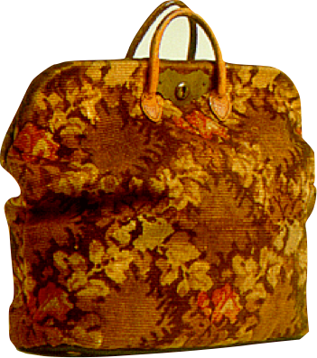
• Carpetbaggers - N. Republicans who moved into the South
- teachers, businessmen, political leaders & greedy men
• Scalawags - White Southern Republicans
- opposed secession
- small farmers
Notes:
^ Remember the Southern Confederates, and many former Southern Confederate, who are bitter about the war, and unhappy about the change are mainly Democrats. But there are REPUBLICANS in the South.
African Americans being a majority of them.
There were however other Republicans in the South. Some were Northerners who came to the South in order to help. Former Union soldiers, black northerners, Freedmen’s Bureau officials, teachers, businessmen, clergy, and political leaders. Southerners didn’t like the Yankees in their land, and they depicted these people as greedy men seeking to grab power or make fast buck. And there were those too. These people came known by Southerners as CARPETBAGGERS. It was an insulting name, named after a cheap suitcase made from carpet scraps
^ Scalawag - To be White and a southerner AND a Republican was to be seen as a traitor. So white Southerners had a name for these tool. SCALAWAG. - Scottish for scrawny cattle.
- consisting of southerners who originally opposed secession, and of small farmers who resented the large plantations.

Slide 3
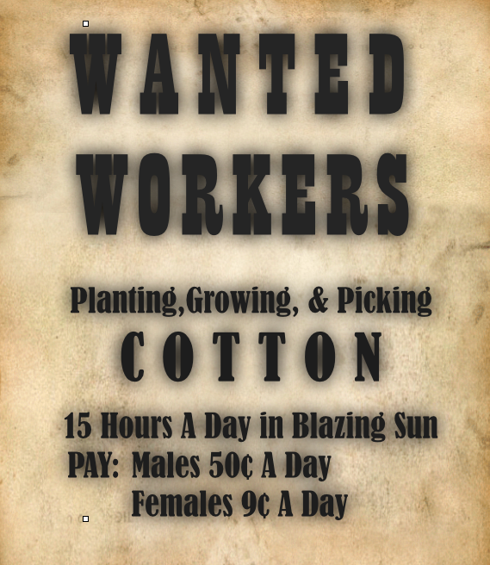
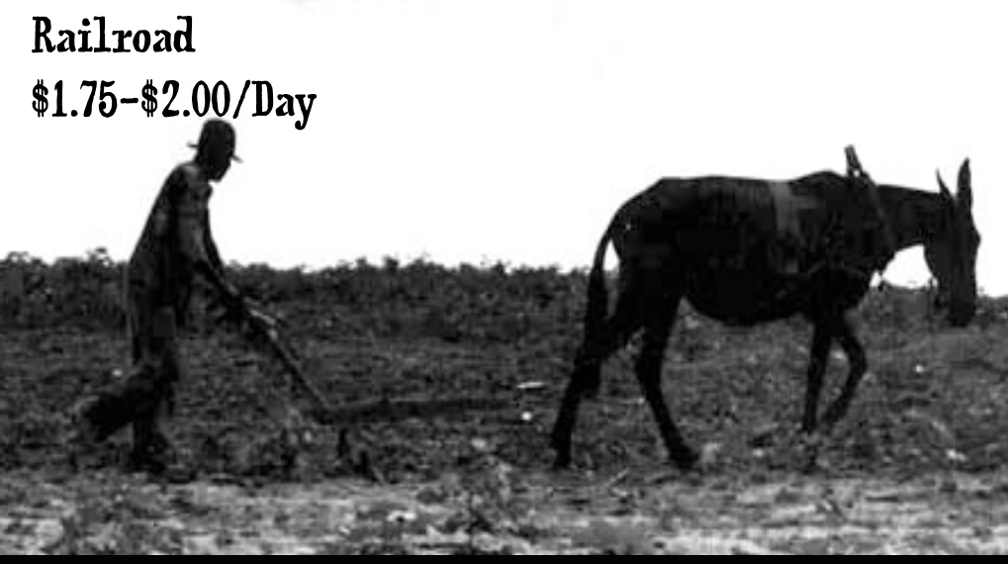
Birth of the “New South”
Notes:
Lecture Notes Key: ^ means discuss before notes
v means discuss after notes
Motivator: Imagine making $1.75-$2.00 a day. That’s what you made if you were working for the railroad in the mid 1800s. Now imagine this(Click for animation), how about $15 a day in in the sun for 15 hours a day. That was one of the few employment options for African Americans in the South.

Slide 4
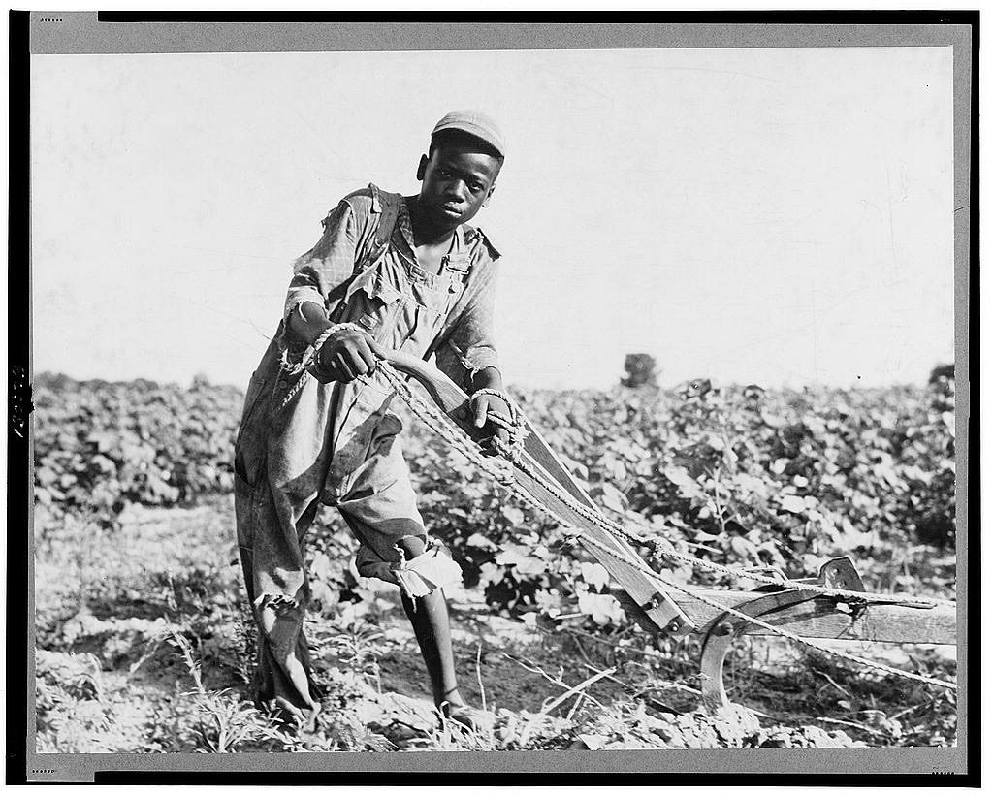
A. Sharecropping -
farmer farms part of owner’s land & gets 1/2 of the crop at harvest.
- some evicted w/o pay
- sharecroppers charged w/ housing & other expenses
B. Tenant Farming
farmer rents land to farm from a owner
Notes:
An embedded link to a 5:53 minute Sharecropping YouTube. Push play.
Mac users, click on black circle to open browser and view a 5:53 minute Sharecropping YouTube video.
Original link: https://www.youtube.com/watch?v=M5VBjwRpvRA&list=UUah6AOt0N8Az0V9URLUQPWA
Sharecropping - Owner of the land gives the farmer credit for seed, tools, living quarters, and food
Worked under supervision, & under threat of harsh punishment. They could be fined for missing a single workday. After the harvest, some dishonest planters simply evicted the sharecroppers without pay. Others charged the families for housing and other expenses, so that the sharecroppers often wound up in debt at the end of the year. Since they could not leave before paying the debt, these sharecroppers were trapped on the plantation.
Tenant - If a Sharecropper saved enough money, he might try tenant farming. Like sharecroppers, tenant farmers did not won the land they farmed. Unlike share croppers, tenant farmers paid to rent the land, like renting an apartment. Tenant chose what they wanted to plant, and when to work. They had higher social status than sharecroppers.

Slide 5
1. Poor whites & freedmen have no jobs, homes, or money for land.
A. Sharecropping -
farmer farms part of owner’s land & gets 1/2 of the crop at harvest.
- some evicted w/o pay
- sharecroppers charged w/ housing & other expenses
B. Tenant Farming
farmer rents land to farm from an owner
5. Sharecropper cannot leave the farm as long as he is in debt to the landlord.
2. Poor whites & freedmen sign contracts to work a landlord’s acreage in exchange for a part of the crop.
4. At harvest time, the sharecropper owes more to the landlord than his share of the crop is worth.
3. Landlord keeps track of the money that sharecroppers owe him for housing & food.
Notes:
Sharecropping - Owner of the land gives the farmer credit for seed, tools, living quarters, and food
Worked under supervision, & under threat of harsh punishment. They could be fined for missing a single workday. After the harvest, some dishonest planters simply evicted the sharecroppers without pay. Others charged the families for housing and other expenses, so that the sharecroppers often wound up in debt at the end of the year. Since they could not leave before paying the debt, these sharecroppers were trapped on the plantation.
Tenant - If a Sharecropper saved enough money, he might try tenant farming. Like sharecroppers, tenant farmers did not won the land they farmed. Unlike share croppers, tenant farmers paid to rent the land, like renting an apartment. Tenant chose what they wanted to plant, and when to work. They had higher social status than sharecroppers.

Slide 6
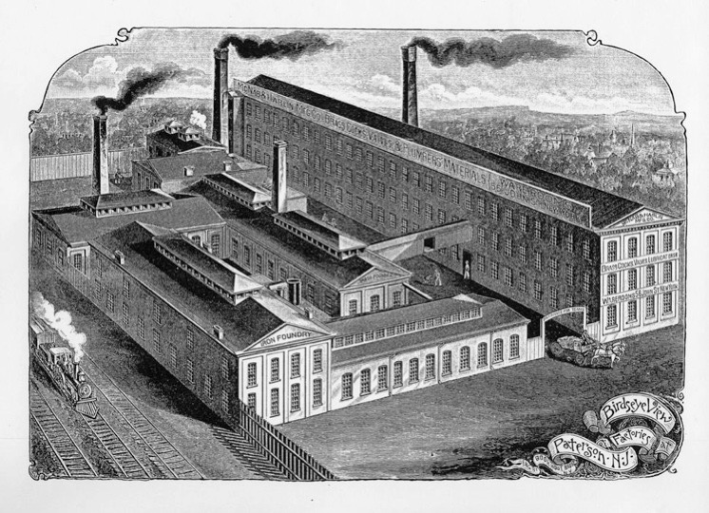
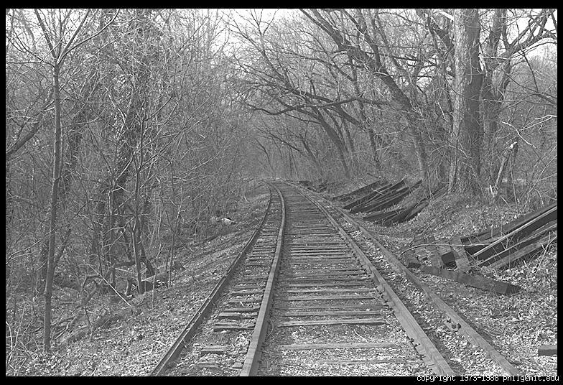
A. Atlanta, Georgia becomes an industrial city
B. 3,300 mi new RR track (40% increase)
- Cotton mills & fabric factories
Notes:
Some Southerners who visited the North after the Civil War were AMAZED at how industrial the North had become. The production of war supplies turned small factories into big industries.
Industrialization had produced a new class of wage erners. It had ignited city growth and generated wealth.
--Some Southern leaders saw new opportunity for the South. They wanted to rebuild the South not just agriculturally, like pre-civil war times, but build a new industrialized one. They were Calling for a NEW South.
A major focus of Reconstruction, and one of its greatest success, was the rebuilding and extension of southern RRs. By 1872, southern railroads were totally rebuilt about 3,3000 miles of new track laid, a 40% increase. RRs turned Southern villages into towns, and towns, into cities where businesses and trade could flourish. Commerce and population rose not only in Atlanta, but also in Richmond, Nashville, Memphis, Louisville, Little Rock, Montgomery and Charlotte.

Slide 7
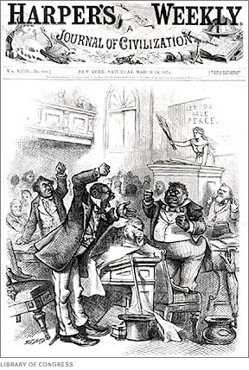
A. Rebuild infrastructure - (Roads, bridges, canals, RR, telegraph) & a public schools added $130 mil. to S. debt.
B. Corruption -
- Much of spending lost to corruption.
- Corruption widespread
- reached Pres. Grant
- S blamed Blacks & carpetbaggers
Notes:
Massive growth caused and influx of a mass amount of money and massive corruption
The worst cases of fraud involved the railroads. A crooked businessman might bribe a key state senator to win a government contract or bid for construction of a new railroad. The businessman would then collect the construction money, use it for personal investments or even a vacation, then declare bankruptcy. In this way numerous railroads were never built, and millions of dollars raised to rebuild the South be gone.
- In South Carolina the legislature even gave $1000 to the Speaker of the House to cover his loss on a horse race.(America Past to present)
And everyone was involved. Blacks, whites, Republicans and democrats, southerners and northerners carpetbaggers. In the end, Reconstruction gets a bad Name.
--Corruption even reached the White House. Early in Grant’s second term, a scandal emerged involving the Credit Mobilier Company. Credit Mobilier had been set up by the owners of the Union Pacific RR to build their portion of the transcontinental RR westward from Omaha. The Union Pacific gave the Credit Mobilier enormous sums of federal money. While some of this money paid for work, much of it went into the pockets of the Union Pacific officers and politicians who were bribed into ignoring the fraud.

Slide 8
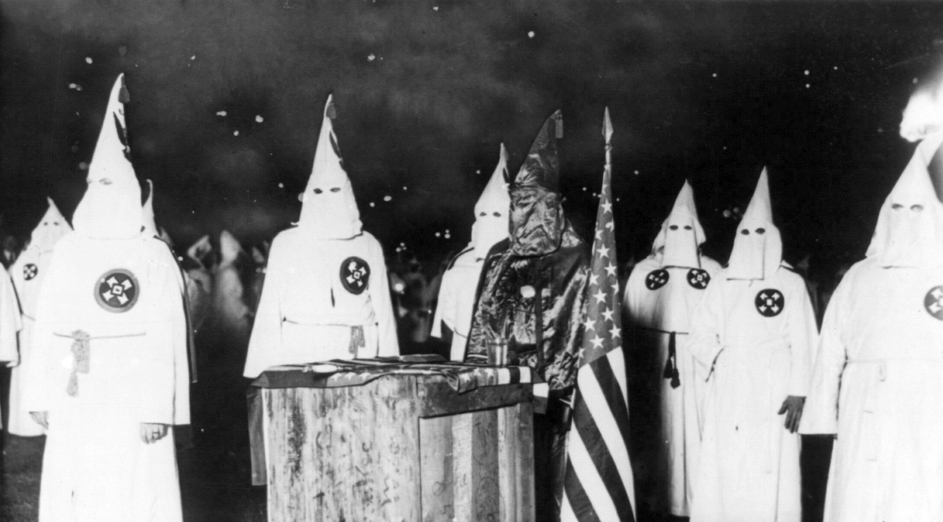
a. Ku Klux Klan
Goal: “to defend the social and political superiority” of whites against what
they called the “aggressions of an inferior race”
- tortured, harassed, kidnapped or killed
- who? carpetbaggers, scalawags, successful blacks.
Notes:
In 1866, What had started out as a social club in Tennessee, became a terrorist group in the South. It was the Ku Klux Klan.
The goal: “to defend the social and political superiority” of whites against what they called the “aggressions of an inferior race”
V. They even terrorized those who learned how to read.

Slide 9
a. Ku Klux Klan
Goal: “to defend the social and political superiority” of whites against what
they called the “aggressions of an inferior race”
- tortured, harassed, kidnapped or killed
- who? carpetbaggers, scalawags, successful blacks.
Notes:
An embedded link to a 2:12 minute KKK YouTube video begins here.
Mac users, click on black circle to open browser and view a 2:12 minute KKK YouTube video.
Original link: https://www.youtube.com/watch?v=Gu3PoOf-Pyk&list=UUah6AOt0N8Az0V9URLUQPWA
In 1866, What had started out as a social club in Tennessee, became a terrorist group in the South. It was the Ku Klux Klan.
The goal: “to defend the social and political superiority” of whites against what they called the “aggressions of an inferior race”
V. They even terrorized those who learned how to read.

Slide 10
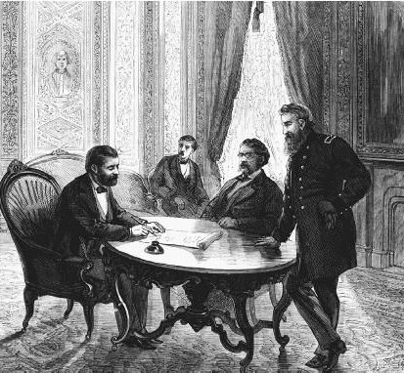
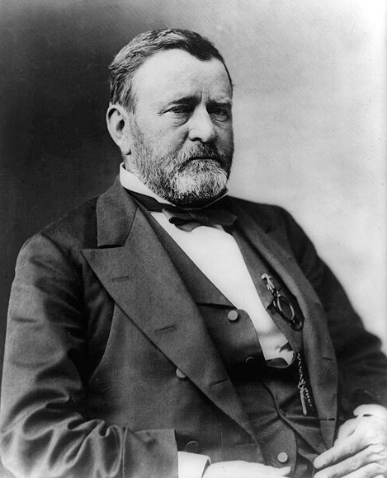
The Enforcement Act (1870)
banned the use of terror, force or bribery to prevent people from voting
- banned the KKK, & strengthened military, courts tried thousands of men
- within a year the Klan was wiped out
Notes:
An embedded link to a 2:12 minute Enforcement Act Youtube video begins next slide .
Mac users, click on black circle to open browser and view a 2:12 minute Enforcement Act Youtube video.
Photo of Grant at table is a link to a Youtube video. Click on photo during presentation to view video.
In 1866, What had started out as a social club in Tennessee, became a terrorist group in the South. It was the Ku Klux Klan.
The goal: “to defend the social and political superiority” of whites against what they called the “aggressions of an inferior race”
V. They even terrorized those who learned how to read.
NEXT SLIDE
= 1. Reconstruction legislatures taxed and spent heavily, putting southern states into deeper debt.
2. Reconstruction came to symbolize corruption, greed, and poor government.
3. White dominated southern states blocked many federal Reconstruction policies.
4. Northern voters never fully supported the Radical’s goal of racial equality
5. A nationwide economic downturn in 1873 diverted public attention from the movement for equal rights

Slide 11
The Enforcement Act (1870)
banned the use of terror, force or bribery to prevent people from voting
- banned the KKK, & strengthened military, courts tried thousands of men
- within a year the Klan was wiped out
Notes:
An embedded link to a 2:12 minute Enforcement Act YouTube video begins here.
Mac users, click on black circle to open browser and view a 2:12 minute Enforcement Act Youtube video.
Original link: https://www.youtube.com/watch?v=dYN3xa6eWFk&list=UUah6AOt0N8Az0V9URLUQPWA
Photo of Grant at table is a link to a YouTube video. Click on photo during presentation to view video.
In 1866, What had started out as a social club in Tennessee, became a terrorist group in the South. It was the Ku Klux Klan.
The goal: “to defend the social and political superiority” of whites against what they called the “aggressions of an inferior race”
V. They even terrorized those who learned how to read.

Slide 12
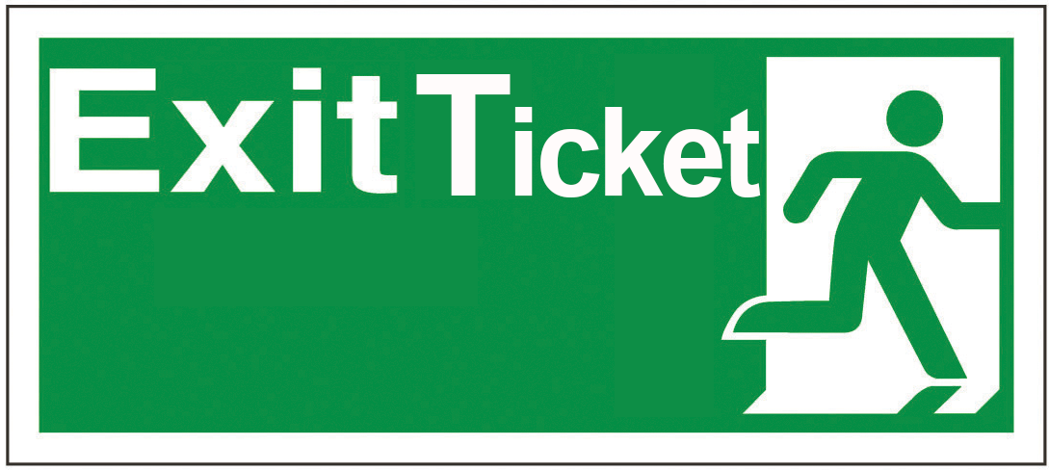
Were did much of the Reconstruction money go towards?

