Slide 1
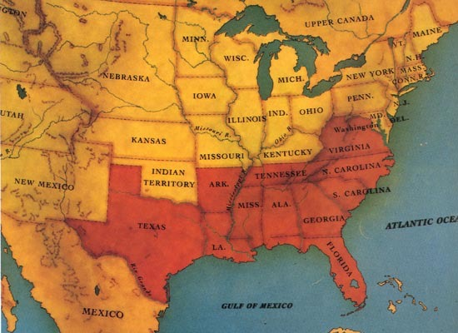
What was the name of Lincoln’s plan for Reconstruction?
As President of the U.S., what would you have done with the South just after the Civil War? Explain.
DAY 2
Place Date Here
Notes:
10 Percent Plan

Slide 2
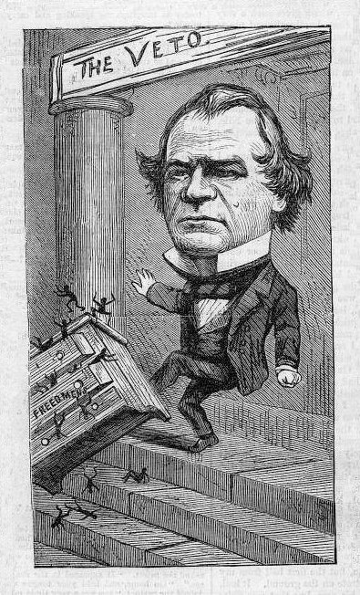
“All persons born or naturalized in the United States, and subject to the jurisdiction thereof, are citizens of the United States”
The Civil Rights Act
Congress passed Civil Rights Act - • outlawed Black Codes.
• Pres. Johnson vetoed, but
Congress overrode it.
14th Amendment 1866
- granted citizenship to & protect
civil rights of liberties of
freedmen
“deprive any person of life, liberty, or property without due process of the law …”
“All Male citizens given suffrage or state loses a portion of their representation”
Notes:
Lecture Notes Key: ^ means discuss before notes
v means discuss after notes
In 1866, Congress passed the Civil Rights act, outlawing these black codes. Johnson, however vetoed the act, and congress had to override his veto by 2/3 vote. They then moved to make the act a Constitutional Amendment, so the Supreme Court couldn’t override the law.
It’s really 3 parts: First a Citizenship Clause provides a broad definition of citizenship that was set out to overrule the Dred Scott decision that which held that blacks could not be citizens of the United States. “All persons born or naturalized in the United States, and subject to the jurisdiction thereof, are citizens of the United States”
Secondly it created a Due Process Clause prohibited state governments from depriving persons of life, liberty, or property without certain steps being taken(That is, due process) It has been used to make most of the Bill of Rights applicable to the States.
It also has an Equal Protection Clause which required each state to provide equal protection under the law to all people. This clause later became the basis for Brown v. Board of Education almost a hundred years later.(1954),
The amendment also includes a number of clauses dealing with the Confederacy and its officials.

Slide 3
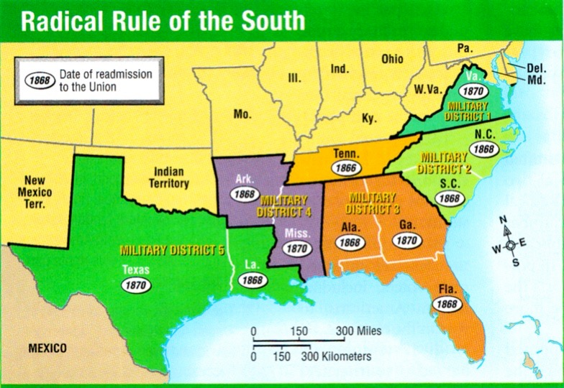
Radical Republicans - favored civil rights for blacks.
Pres. Johnson - opposed.
Reconstruction Act of 1867
1. S. States under military rule
2. States required to give the
vote to all qualified males
(including blacks)
3. Supporters of the Confederacy couldn’t vote
4. States must ratify 14th Amendment
Notes:
NEW Radical republicans are able to convince moderates to their plan. Johnson’s Veto, Race Riots in the South,(meaning white mobs were killing blacks) and Black Codes convinced moderates that they had to take over Reconstruction-that Johnson’s plan wasn’t working and in fact, Johnson himself was getting in the way.
=There is a small group in congress called the Radical Republicans. They favored Civil Rights - right to vote, equal treatment with whites. But most did not. Including the President himself.
They wanted to be able to enforce the 14th amendment, and to STOP all racial violence in the South.
Most Northerners did not agree with them.
--- Keep in Mind that the North are Republicans, and the South is Democrat. This will solidify the South’s commitment in voting democrat.
V Until. . . .Word gets out in the North how black are being treated in the South. The civil war nurse Clara Barton told of injured black victims she had treated. White rioters rampaged against African Americans in throughout the south. White police joined in the stabbings, shootings, and hangings that kill hundreds.
Still Johnson opposed equal rights. This persuaded public opinion toward the Radical Republicans, and they were able to pass their own Reconstruction goals. This was the RECONSTRUCTION ACT of 1867 - Click
^1. First it invalidated the state governments formed under Lincoln/Johnson’s plan
V ALL---Once Congress approved the new state constitution, one the state legislature ratified the 14th amendment, and once the amendment became part of the federal Constitution, Congress would readmit the state into the Union-and Reconstruction of that state would be complete.

Slide 4
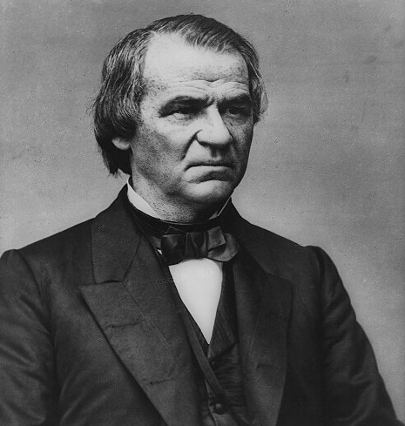
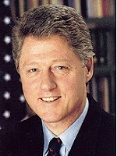
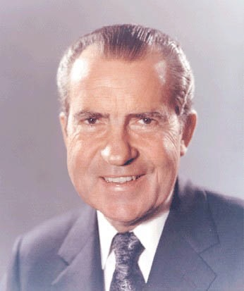
1868 - Johnson impeached
Senate tried Pres. Johnson but he escaped by one vote.
IMPEACHED
IMPEACHED
Resigned
Notes:
The Radical Republicans absolutely are against Johnson’s Views. . . and vice versa.
Tenure of Office Act - prohibited the president from removing civil officers without Senate consent.
Early in 1868, the government crisis came to a climax. President Johnson attempted to fire his Secretary of War, Edwin Stanton who was a Radical Republican, without Senate approval. Stanton had been working with the Radicals to undermine Johnson's reconstruction policies. Firing Stanton violated the Tenure of Office Act. The Radicals blocked Johnson's attempt to test the constitutionality of this law in the Supreme Court.
On February 24, 1868, the House of Representatives voted to impeach President Johnson. Congress wanted Johnson impeached because he refused to cooperate or compromise over black rights and the reconstruction of Southern state governments. But under the Constitution, Congress had to charge him with "high crimes or misdemeanors."
Do you know what other president in American history has been impeached?
Click for Clinton. Click for Nixon – He resigned before he could be impeached.
Until Clinton, Johnson went down in history as the only president to be impeached. He survived impeachment by one vote.

Slide 5
1868 - Johnson impeached
Senate tried Pres. Johnson but escaped by one vote.
• Next election, Republican Ulysses S. Grant won the Presidency.
• Radical Republicans won more seats.
Notes:
An embedded link to a 2:12 minute 1868 Election YouTube video begins here.
Mac users, click on black oval to open browser and view a 2:12 minute 1868 Election YouTube video.
Original link: https://www.youtube.com/watch?v=SqQWkDnulF8
The Radical Republicans absolutely are against Johnson’s Views. . . and vice versa.
Early in 1868, the government crisis came to a climax. President Johnson attempted to fire his Secretary of War, Edwin Stanton, without Senate approval. Stanton had been working with the Radicals to undermine Johnson's reconstruction policies. Firing Stanton violated the Tenure of Office Act. The Radicals blocked Johnson's attempt to test the constitutionality of this law in the Supreme Court.
On February 24, 1868, the House of Representatives voted to impeach President Johnson. Congress wanted Johnson impeached because he refused to cooperate or compromise over black rights and the reconstruction of Southern state governments. But under the Constitution, Congress had to charge him with "high crimes or misdemeanors."
Until Clinton, Johnson went down in history as the only president to be impeached.
Johnson may have beat impeachment, but he sure wouldn’t win the next election. The Republicans would elect an old war hero. It seems to be the case.

Slide 6
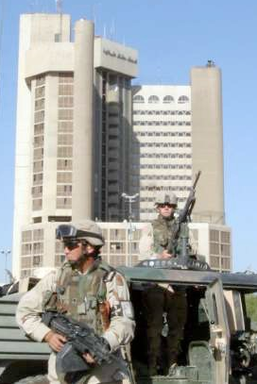
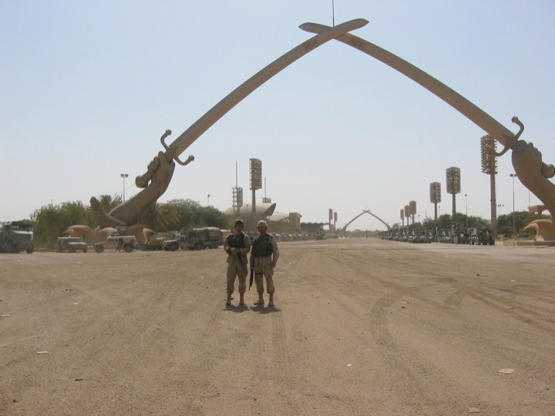
15th Amendment 1869, granted African American males to vote.
no citizen may be denied the right to vote “by race, color or previous condition of servitude.”
• 1870, U.S. troops guarded voting polls, allowing black males to vote
Notes:
Across the South, freedmen were beginning to demand the rights of citizenship: vote, to hold public office, to serve on juries, and to testify in court. Radical Republicans in Congress, with their newly elected power, passed the Fifteenth Amendment to Constitution. It stated that no citizen may be denied the right to vote “by race, color or previous condition of servitude.”
servitude: a condition in which one lacks liberty especially to determine one's course of action or way of life
In 1870, nearly 130 years ago, U.S. troops were doing the exact same thing they were doing in Iraq this month. They were stationed across the South, protecting people trying to vote. Black men proudly voted for the first time. Many angry white voters stayed home. They were protesting. They were idiots. If they really wanted to fight the situation they would have voted. But they didn’t.
This enabled more than 600 African Americans to get elected in southern legislatures.

Slide 7
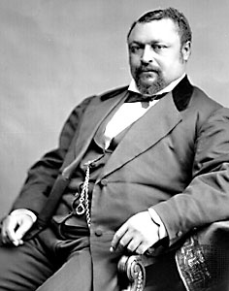
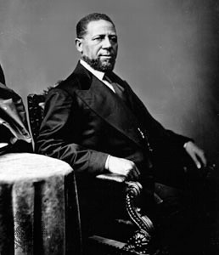
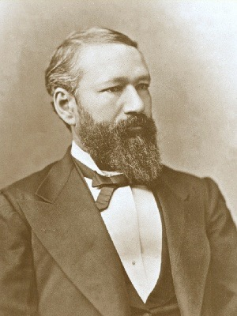
Blanche K. Bruce
Hiram Revels
P.B.S. Pinchback
• Over 600 African Americans elected to state legislatures
• Louisiana gained a black governor
• Hiram Revels became the 1st African American elected to Senate
Notes:
This enabled more than 600 African Americans to get elected in southern legislatures.
Blanch - a former slave, learned how to read and write as a slave, went to Oberlin College in Ohio until he ran out of money. becomes a U.S. Senator
PBS Pinchback - Louisiana governor - In 1872, the incumbent Republican governor Henry Clay Warmoth, suffered impeachment charges near the end of his term. State law required that Warmoth step aside until convicted or cleared of the charges. Pinchback, as lieutenant governor, succeeded as governor on December 9 and served for 35 days until the end of Warmoth's term. Warmoth was not convicted and the charges were eventually dropped.
The South became even more enraged
The U.S. Senate get two black senators. Since 1969, we’ve had four one President Barak Obama and another his replacement who was appointed by a corrupt governor.

Slide 8
How did Congressional Reconstruction help Freedmen in the South?

