Slide 1
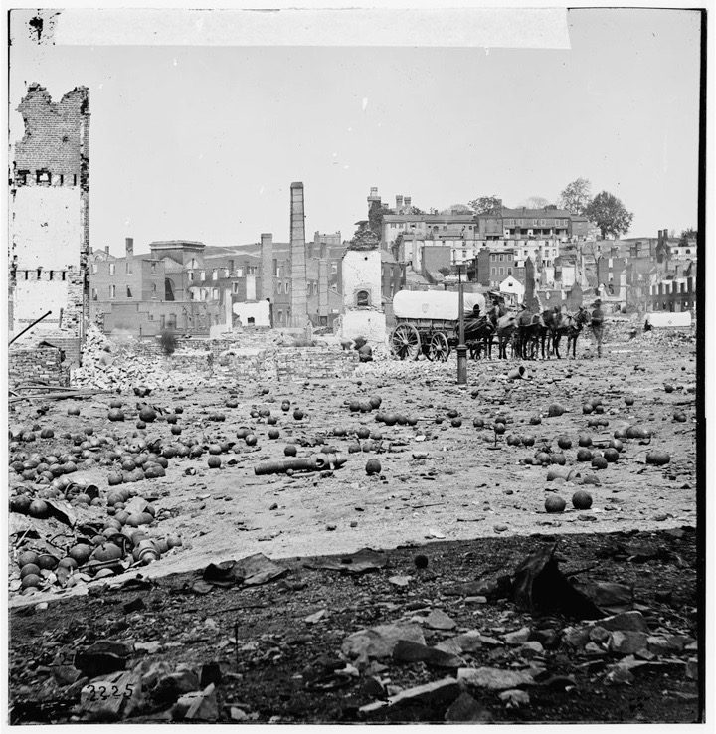
What were some of the lasting impacts of the Civil War?
Day 1
Place Date Here
Write in full sentences. If not, no credit.
Notes:
1. End of Slavery - In the end 3.5 million slaves
2. Weakening of states rights - The country was more 1 rather than a series of states. The idea of states rights would not disappear, but states would never again talk about secession.
3. creation of a national banking system- created 1863 and replaced state banks, and the use of “greenbacks”.
4. promotion of large scale business -Giant RR corporation w/thousand of employees and huge Sanitary Commission with power
5. expanded federal powers - Imposed a federal income tax - National Gov. over State Gov. - The Federalist won - the anti-federalist lost.

Slide 2
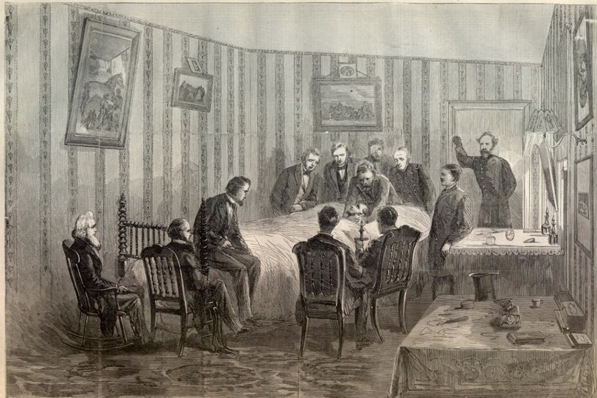
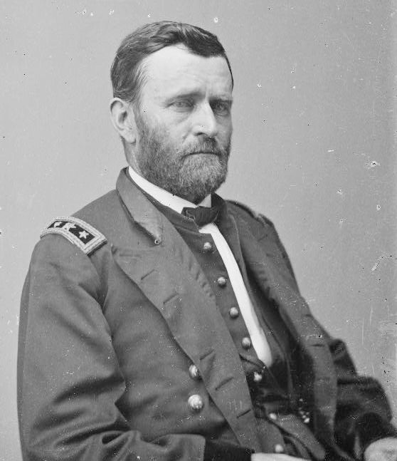
REVIEW: APPOMATTOX April 1865
a. Lee forced to retreat from Petersburg, VA, low on supplies & 30,000 men
b. Lee surrenders at Appomattox Courthouse
April 9, 1865
Ulysses S. Grant
Robert E. Lee
Notes:
Lecture Notes Key: ^ means discuss before notes
v means discuss after notes
REVIEW: Appoe-Matix
1.A tired and weak Lee retreated to Appomattox Courthouse, VA.
2. Lee surrendered to grant April 9, 1865.
3. Lee’s men were given 3 days of food and sent home.
4. Jefferson Davis was captured May 1 in Georgia, on his way to Texas.
Six days later Lincoln was assassinated April 14, 1865 at Ford’s Theatre in Washington, DC, by John Wilks Booth.
Booth, jumped on stage after the assassination and yelled “Such is always the fate of tyrants”!
-It was part of a larger conspiracy in an effort to rally the remaining Confederate troops to continue fighting. It consisted of Secretary of State, William H. Seward and Vice President Andrew Johnson. Although Booth succeeded in killing Lincoln, the larger plot failed. Seward was attacked was attacked in his bedroom by a knife, but his son was able to stop the attack, he but recovered from his wounds, and Johnson's would-be assassin fled Washington, D.C. because he chickened out.
- 8 were accused of being accomplices, 4 were hanged, the rest imprisoned.
Lincoln was the first American president to be assassinated,[1] though in 1835 an attempt had been made to assassinate Andrew Jackson.[2]

Slide 3
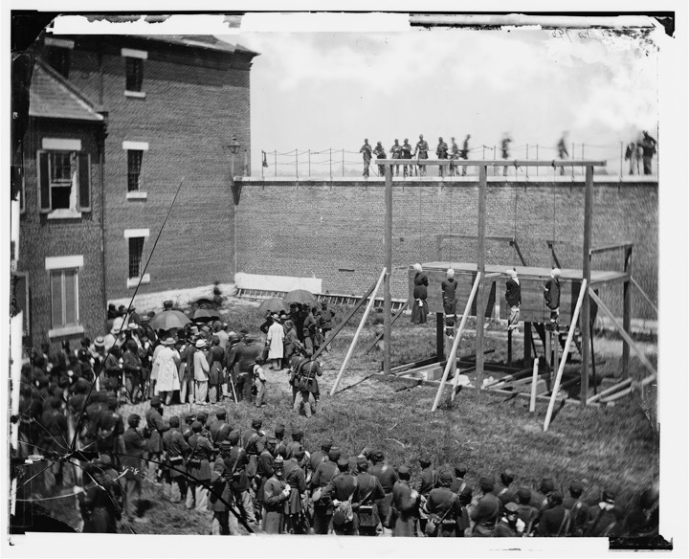
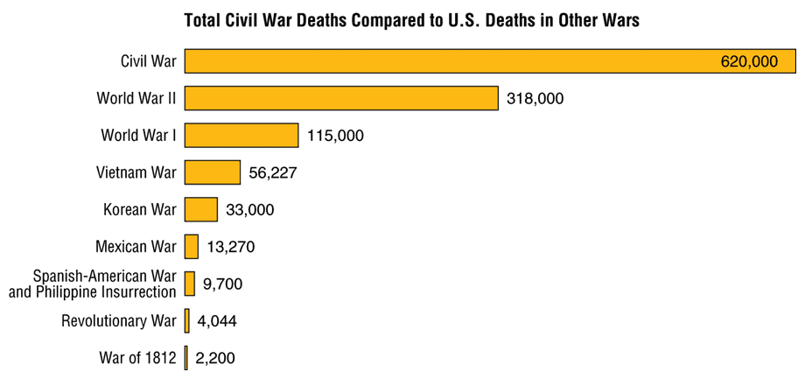
RECONSTRUCTION
13th AMENDMENT
Section 1. Neither slavery nor involuntary servitude, except as a punishment for crime whereof the party shall have been duly convicted, shall exist within the United States, or any place subject to their jurisdiction.
Section 2. Congress shall have power to enforce this article by appropriate legislation.
CHAPTER 16
Notes:
Six days later Lincoln was assassinated April 14, 1865 at Ford’s Theatre in Washington, DC, by John Wilks Booth.
Booth, jumped on stage after the assassination and yelled “Such is always the fate of tyrants”!
It was part of a larger conspiracy in an effort to rally the remaining Confederate troops to continue fighting. It consisted of Secretary of State, William H. Seward and Vice President Andrew Johnson. Although Booth succeeded in killing Lincoln, the larger plot failed. Seward was attacked was attacked in his bedroom by a knife, but his son was able to stop the attack, he but recovered from his wounds, and Johnson's would-be assassin fled Washington, D.C. because he chickened out.
- 8 were accused of being accomplices, 4 were hanged, the rest imprisoned.
Lincoln was the first American president to be assassinated, though in 1835 an attempt had been made to assassinate Andrew Jackson.

Slide 4
Notes:
The war had destroyed two thirds of southern shipping and 9,000 miles of railroads. It had destroyed farmland, farm buildings and farm machinery, work animals, and 1/3 of livestock.
It had destroyed bridges, canals and thousands of miles of roads.
The North had lost 364,000 soldiers, including 38,000 African Americans.
The South, 260,000 soldiers 1/5 of its white men. 1 out of every 3 men were killed or injured.
After the Civil war, the south was in shambles. These are pictures of Richmond, Virginia after the war.
The South needs to be rebuilt.
The North now has to decide what they are going to with the South. They were once their enemy, but they are also a part of the United States. Should they punish them? What would you do?

Slide 5
Notes:
The war had destroyed two thirds of southern shipping and 9,000 miles of railroads. It had destroyed farmland, farm buildings and farm machinery, work animals, and 1/3 of livestock.
It had destroyed bridges, canals and thousands of miles of roads.
The North had lost 364,000 soldiers, including 38,000 African Americans.
The South, 260,000 soldiers 1/5 of its white men. 1 out of every 3 men were killed or injured.
After the Civil war, the south was in shambles. These are pictures of Richmond, Virginia after the war.
The South needs to be rebuilt.
The North now has to decide what they are going to with the South. They were once their enemy, but they are also a part of the United States. Should they punish them? What would you do?

Slide 6
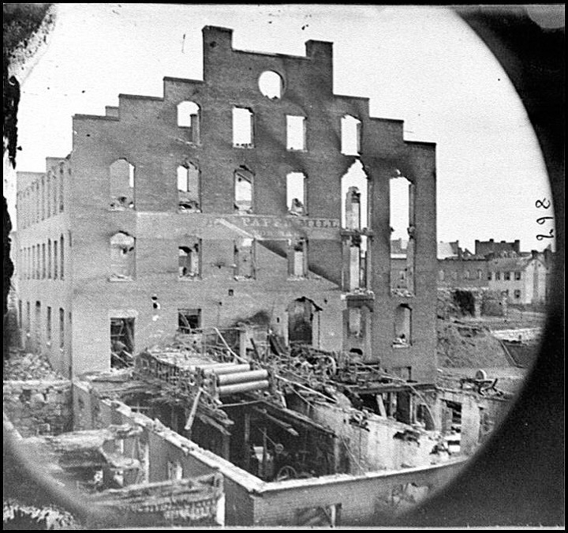
Notes:
The South was destroyed

Slide 7
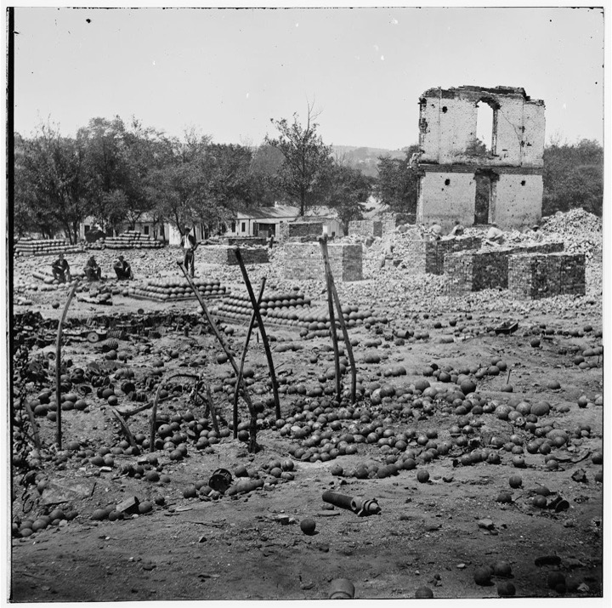
North - 364,000 Dead
South - 260,000 1/5 of its white men dead
9,000 miles of railroad destroyed
Destroyed: farmland, farm buildings, farm machinery, work animals, 1/3 of all southern livestock, bridges, canals, thousands of miles of roads. . .
Notes:
The war had destroyed two thirds of southern shipping and 9,000 miles of railroads. It had destroyed farmland, farm buildings and farm machinery, work animals, and 1/3 of livestock.
It had destroyed bridges, canals and thousands of miles of roads.
The North had lost 364,000 soldiers, including 38,000 African Americans.
The South, 260,000 soldiers 1/5 of its white men. 1 out of every 3 men were killed or injured.
After the Civil war, the south was in shambles. These are pictures of Richmond, Virginia after the war.
The South needs to be rebuilt.
The North now has to decide what they are going to with the South. They were once their enemy, but they are also a part of the United States. Should they punish them? What would you do?

Slide 8
I. Reconstruction 1865-1877
attempt to repair damage to the south & bring southern states to the Union.
A. Black Southerners
4 million freed - now homeless, jobless, & hungry
B. Plantation owners
lost slave labor worth 3 billion. Couldn’t afford to hire workers
C. Poor White Southerners
no work, many moved west
Notes:
The war had destroyed two thirds of southern shipping and 9,000 miles of railroads. It had destroyed farmland, farm buildings and farm machinery, work animals, and 1/3 of livestock.
It had destroyed bridges, canals and thousands of miles of roads.
The North had lost 364,000 soldiers, including 38,000 African Americans.
The South, 260,000 soldiers 1/5 of its white men. 1 out of every 3 men were killed or injured.
After the Civil war, the south was in shambles. These are pictures of Richmond, Virginia after the war.
The South needs to be rebuilt.
The North now has to decide what they are going to with the South. They were once their enemy, but they are also a part of the United States. Should they punish them? What would you do?
Many plantation owners were surprised when their former slaves refused to work for them for pay. But some did, and the reconstruction process began.

Slide 9
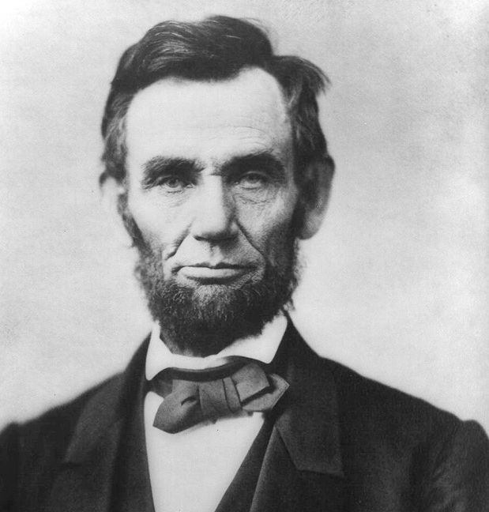
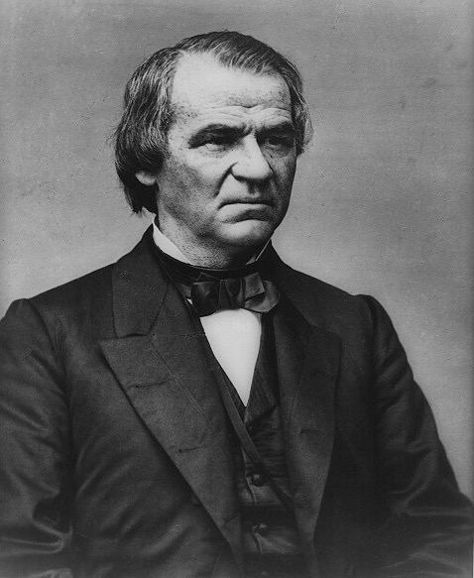
II. Two Reconstruction Plans
The Johnson Plan aka
Presidential Reconstruction
The Lincoln Plan (10% Plan)
• pardoned Confederates who swore allegiance to the Union & emancipation
• states hold constitutional conventions when 10% of voters swear allegiance to the Union,
• then can return to Union
• pardoned Confederates who swore allegiance to the Union
• states hold a constitutional convention (w/o 10%)
• states void secession, end slavery, & ratify 13th Amendment.
• then can return to Union
Notes:
So this civil war outlawed Slavery, but it could not outlaw racism - and that would be the biggest challenge of Reconstruction
^. (Lincoln)How and when should the southern states be allowed to resume their role in the Union? Should the South be punished for its actions or be forgiven and allowed to recover quickly? Now that black southerners were free, would the races have equal rights? Did the Civil War itself show the need for a stronger Federal Government?
Plans Emerge. The first was the Lincoln Plan. Lincoln had begun his postwar plan around December 1863.
In December 1863, Lincoln issued the Proclamation of Amnesty and Reconstruction, which outlined a path by which each southern state could rejoin the Union.
1. Oath to the allegiance to the Union and accept emancipation.
4. His plan excluded some southerners from taking the oaths: Confederate government officials, army and naval officers, as well as those military officers who had resigned from congress or from U.S. commissions in 1861. They would all have to apply for presidential pardons. Also blacks - they couldn’t vote. . ..yet.
Harsh or Lenient????
Radical Republicans in the Congress believed the plan was too lenient. They also believed that the president didn’t have the power to propose such a plan, Congress should draft the plan.
Unfortunately, Lincoln was assassinated April 14, 1865.
Andrew Johnson. - Was a democrat. He was put on Lincoln’s ticket in order to make peace with anti-Northerners. A former slave owner from North Carolina. Born poor, he became a tailor and later learned how to read & write from his wife. He would be known as one of the worst presidents in U.S. history.
When he came into office, he constructed his own plan.
V. Which was more generous?

Slide 10
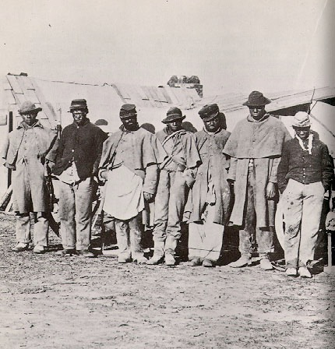
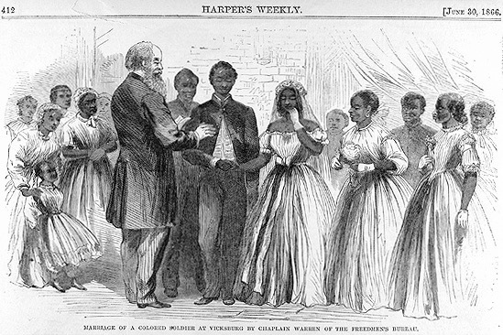
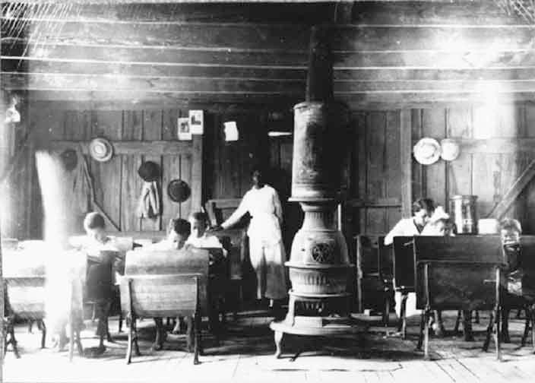
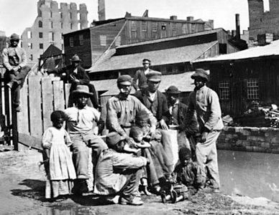
III. FREEDOM
1. Freedmen - name for free blacks
2. Freedmen’s Bureau - helped black southerners start schools - gave out clothing, medical supplies, meals etc.
Notes:
As soon as the war was over, thousands of freed slaves walked away from their plantations. They took to the roads looking for family members who had been sold off to other plantations. Not all were successful in finding loved ones.
In addition, many couples who had been forbidden to marry under slavery now found each other and got LEGALLY married.
It was illegal to teach African Americans to read and write, so after the war, many flocked to schools set up by the Freedman’s Bureau.
But they were left with nothing. There were proposals to redistribute white owned land to freedmen. Proposals came from groups like the FREEDMAN’S Bureau who said that generations of African Americans had worked the land, and therefor had the rights to the land. They were soon ignored.

Slide 11
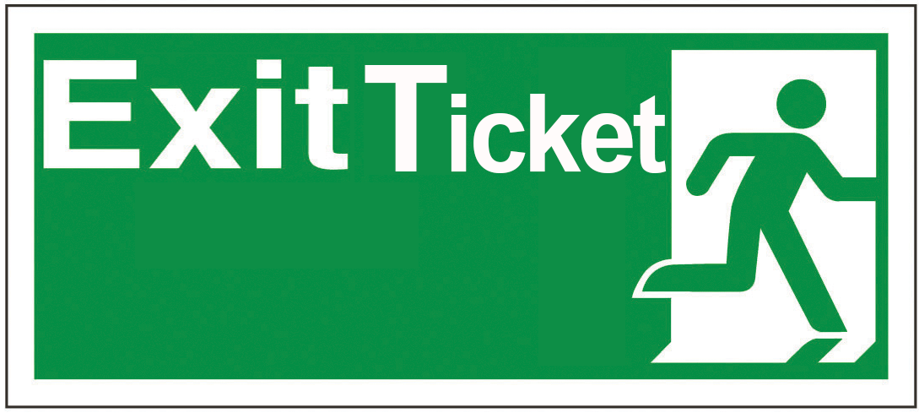
Who’s plan was more lenient on the South, Lincoln’s or Johnson’s?

